Slide 1
Database Management System DSE 2252
4 Credits
Reference:
Database System Concepts , 6th Edition
Authors:
Abraham Silberschatz
Henry F. Korth
S. Sudarshan

Slide 2
Duration
Course Plan – 48 hours
Per Week – 4 hours (3+1)
Other References -
Fundamentals of Database System, 6th Edition
Ramez Elmasri, Shamkant Navathe,
Addison Wesley Publications Co., 2010.
Database Management System 3rd Eddition
Raghu Ramakrishnan, Johannes Gehrke,, 3rd Edition,
WCB/McGraw Hill Publisher, 2014.
Notes:
Other References:

Slide 3
Evaluation Pattern
Internal Assessment(50%)
Two Sessional (15 marks each) - 30
Four Assignments (5+5+5+5) - 20
End Semester Assessment(50%)
Written Exam of 3 hours duration - 50
TOTAL 100
50
Jan 23
Notes:
50

Slide 4
Assignments Schedule

Slide 5
Main Concepts Discussed
Database concepts, data models and database architecture.
Manipulate, retrieve the data from database using SQL, PL/SQL.
Database Design – ER Model & Normalization.
Database Query execution, Transaction Management , Concurrency & Recovery.
Unstructured Database.

Slide 6
Syllabus
DSE 2252 DATABASE SYSTEMS [3 1 0 4]
Introduction: Database System Applications, View of data, Database languages, Database users and Administrator.
Introduction to Relational Model: database schema, keys, schema diagrams, Relational Query Languages, Relational Introduction to SQL: Data Definition, Basic structure of SQL queries, Basic operations, Set operations, Null values, Aggregate Functions, Nested subqueries, Modification of the database. Intermediate SQL: Join expressions, Views, Transactions,
Integrity Constraints, SQL Data types and schemas, Authorization,
Advanced SQL-PL/SQL, Cursors, Functions, Procedures, Triggers, recursive queries, advanced aggregation features.
Database Design and Entity-Relationship Model: Design Process, ER Model, Reduction to Relational schema.
Relational Database design: Functional dependencies, Normal forms, Closure, Canonical cover,
Lossless joins , dependency preserving decomposition
Storage and File structure, Indexing & Hashing.
Query Processing, Overview, Measure of query cost, selection, Join operation, sorting, Evaluation of
expressions.
Query Optimization: Overview, Estimating statistics of expression results, Materialized
Views.
Transactions: Concepts, Simple transaction model, Transaction atomicity and durability, Transaction Isolation, Serializability, Transaction Isolation Levels.
Concurrency Control- Lock based protocols, Deadlock Handling, Multiple granularity,
Recovery System: Failure classification, Storage, Recovery algorithm, Buffer Management.
Unstructured database: Introduction to NoSQL, Basics of document-oriented database, MongoDB.

Slide 7
Some Definitions
Database A shared collection of logically interrelated data (and a description of this data), designed to meet the information needs of an organization.
DBMS Database & software system that facilitates the process of defining, constructing, manipulating and sharing databases among users and applications.
Example: Oracle, MySQL
Notes:
A database-management system (DBMS) is a collection of interrelated data and a set
of programs to access those data. The collection of data, usually referred to as the
database, contains information relevant to an enterprise. The primary goal of a DBMS
is to provide a way to store and retrieve database information that is both convenient
and efficient.
Database systems are designed to manage large bodies of information. Management
of data involves both defining structures for storage of information and providing
mechanisms for the manipulation of information. In addition, the database system
must ensure the safety of the information stored, despite system crashes or attempts
at unauthorized access. If data are to be shared among several users, the system must
avoid possible anomalous results.

Slide 8
Database Applications-
Name some database Applications -
Enterprise Information- Sales, Accounting, Human resources.
Banking and Finance-
Customer, Accounts, Card details & transaction
Telecommunication:
calls, texts, and data usage, generating bills, balances, n/w information
Social-media:
Online advertisements:
Document databases:
The database systems arose in the 1960s
Notes:
The database systems arose in the 1960s in response to the computerized management of commercial data. What was the system used to store before 1960s

Slide 9
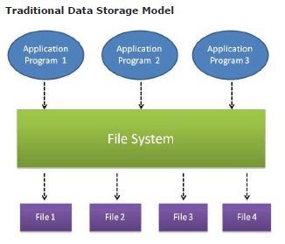
Traditional File-oriented Data Storage
In traditional approach, information is stored in flat files which are maintained by the file system under the operating system’s control.
Application programs access through the file system in order to access these flat files
Notes:
Structure of File Tightly Coupled in Application Logic
No Sharing – No concurrent access
Difficulty in Constraints implementation and Modifying.
Security- Read, Write on the file. But not Role based.
The database systems arose in the 1960s in response to the computerized management of commercial data.

Slide 10
Why Database Systems?
Database systems were developed to handle the following difficulties of a typical file-processing systems:
Data redundancy and inconsistency
Difficulty in accessing data
Data isolation – multiple files and formats
Integrity problems-consistency constraints
Atomicity of updates
Concurrent access by multiple users
Security problems

Slide 11
Drawbacks of using file-processing systems to store data
Data redundancy and inconsistency
Multiple file formats, duplication of information in different files.
Ex: if a student has a double major (say, music and mathematics) , his personal information( say Phone number/ Address) may be stored in both the departments.
Same personal information about student stored at two different places(redundancy).
Inconsistency- various copies of the same data may no longer agree

Slide 12
Drawbacks of using file-processing systems to store data
Difficulty in accessing data
Need to write a new program to carry out each new task.
Ex: A program retrieves “customer information who are in any given city”. Assume later point of time a requirement arises to “find customers who are in a given city and balance is above 100000/-”. Now old programs so not work, so you need to put some manual effort or write another program. Both are time consuming.
Do not allow needed data to be retrieved in a convenient and efficient manner.
Notes:
Difficulty in accessing data– In era of fil oriented system, programs are developed by different programmers over period using different programming languages and DATA STORED IN different file formats. All related data not available in one file data is scattered over different files and they may have different format. Therefore writing new application to access those data is difficult.
Ex: A program retrieves customer information who are in any given city. Assume later point of time a requirement arises to find customers who are in a given city and balance is above 100000/-. Now old programs so not work, so you need to put some manual effort or write another program. Both are time consuming.
Data isolation — multiple files and formats
Over the time different developers might have developed programs and correspondingly data files under different programming languages. Structure of file is tightly coupled with the program. A new program in different language accessing file existing some old format may be difficult.
But in case of database systems, data is independent of application developed and as long as data new application developing environment(language/tool) has API to get connected with the existing database.
Assume , SBI has already existing Database system and some application was developed say using VB , after 10 years say we need to accesses some data through Java application program. It can happened as long as java can get connected to existing database using JDBC interface.
Example for data Isolation: Imagine we have to generate a single report of student, who is studying in particular class, his study report, his library book details, and hostel information. All these information's are stored in different files. How do we get all these details in one report? We have to write a program. But before writing the program, the programmer should find out which all files have the information needed, what is the format of each file, how to search data in each file etc. Once all these analysis is done, he writes a program. If there is 2-3 files involved, programming would be bit simple. Imagine if there is lot many files involved in it? It would be require lot of effort from the programmer. Since all the data are isolated from each other in different files, programming becomes difficult.

Slide 13
Drawbacks of using file-processing systems to store data
Data isolation — multiple files and formats
Over the time different developers might have developed programs and correspondingly data files(different formats) under different programming languages.
i.e. Data are scattered in various files with different file formats.
Structure of file is tightly coupled with the program.
Notes:
Difficulty in accessing data– In era of fil oriented system, programs are developed by different programmers over period using different programming languages and DATA STORED IN different file formats. All related data not available in one file data is scattered over different files and they may have different format. Therefore writing new application to access those data is difficult.
Ex: A program retrieves customer information who are in any given city. Assume later point of time a requirement arises to find customers who are in a given city and balance is above 100000/-. Now old programs so not work, so you need to put some manual effort or write another program. Both are time consuming.
Data isolation — multiple files and formats
Over the time different developers might have developed programs and correspondingly data files under different programming languages. Structure of file is tightly coupled with the program. A new program in different language accessing file existing some old format may be difficult.
But in case of database systems, data is independent of application developed and as long as data new application developing environment(language/tool) has API to get connected with the existing database.
Assume , SBI has already existing Database system and some application was developed say using VB , after 10 years say we need to accesses some data through Java application program. It can happened as long as java can get connected to existing database using JDBC interface.
Example for data Isolation: Imagine we have to generate a single report of student, who is studying in particular class, his study report, his library book details, and hostel information. All these information's are stored in different files. How do we get all these details in one report? We have to write a program. But before writing the program, the programmer should find out which all files have the information needed, what is the format of each file, how to search data in each file etc. Once all these analysis is done, he writes a program. If there is 2-3 files involved, programming would be bit simple. Imagine if there is lot many files involved in it? It would be require lot of effort from the programmer. Since all the data are isolated from each other in different files, programming becomes difficult.
In traditional file approach, application programs are closely dependent on the files in
which data is stored. If we make any changes in the physical format of the file(s), like
addition of a data field , etc, all application programs needs to be changed accordingly.
Consequently, for each of the application programs that a programmer writes or
maintains, the programmer must be concerned with data management. There is no
centralized execution of the data management functions. Data management is scattered
among all the application programs.
Example:
Consider the banking system. An employee_salary file exists which has details about the
salary of employees. An employee_salary record is described by
employee_id, firstname, lastname, salary_amount
An application program is available to display all the details about the salary of all
employees. Assume a new data field, the date_of_joining is added to the employee_salary
file. Since the application program depends on the file, it also needs to be altered.
If the physical format of the employee_salary file for example the field delimiter, record
delimiter, etc. are changed, it necessitates that the application program which depends on
it, also be altered.

Slide 14
Drawbacks of using file-processing systems to store data
Integrity problems
Integrity constraints (e.g. “dept_name field value of student must be a valid department name” or “Balance of an Account Maintained by the department must be more than 10000/-”) become “buried” in program code rather than being stated explicitly.
Hard to add new constraints or change existing ones.
Notes:
Making changes to an existing file structure in a file based system environment, it needs extensive programming. For example, changing just one field in the original CUSTOMER file would require a program that:
1. Reads a record from the original file.
2. Transforms the original data to conform to the new structure’s storage requirements.
3. Writes the transformed data into the new file structure.
4. Repeats steps 2 to 4 for each record in the original file.
In traditional file approach, application programs are closely dependent on the files in
which data is stored. If we make any changes in the physical format of the file(s), like
addition of a data field , etc, all application programs needs to be changed accordingly.
Consequently, for each of the application programs that a programmer writes or
maintains, the programmer must be concerned with data management. There is no
centralized execution of the data management functions. Data management is scattered
among all the application programs.
Example:
Consider the banking system. An employee_salary file exists which has details about the
salary of employees. An employee_salary record is described by
employee_id, firstname, lastname, salary_amount
An application program is available to display all the details about the salary of all
employees. Assume a new data field, the date_of_joining is added to the employee_salary
file. Since the application program depends on the file, it also needs to be altered.
If the physical format of the employee_salary file for example the field delimiter, record
delimiter, etc. are changed, it necessitates that the application program which depends on
it, also be altered.

Slide 15
Drawbacks of using file-processing systems to store data
Atomicity of updates
Failures may leave database in an inconsistent state if the partial updates are executed.
Example: Account A has balance 1000 and B has 2000.
Transfer of funds 100/- from one account A to another B should either complete or not happen at all.
Notes:
Consider a program to transfer $500 from the account balance of department A to
the account balance of department B. If a system failure occurs during the
execution of the program, it is possible that the $500 was removed from the
balance of department A but was not credited to the balance of department B,
resulting in an inconsistent database state. Clearly, it is essential to database
consistency that either both the credit and debit occur, or that neither occur.
Oracle-Two-Phase Commit Mechanism
The database two-phase commit mechanism guarantees that all database servers participating in a distributed transaction either all commit or all roll back the statements in the transaction.
A database must guarantee that all statements in a transaction, distributed or non-distributed, either commit or roll back as a unit. The effects of an ongoing transaction should be invisible to all other transactions at all nodes; this transparency should be true for transactions that include any type of operation, including queries, updates, or remote procedure calls.
The general mechanisms of transaction control in a non-distributed database are discussed in the Oracle Database Concepts. In a distributed database, the database must coordinate transaction control with the same characteristics over a network and maintain data consistency, even if a network or system failure occurs.
A two-phase commit mechanism also protects implicit DML operations performed by integrity constraints, remote procedure calls, and triggers.
https://docs.oracle.com/en/database/oracle/oracle-database/18/admin/distributed-database-concepts.html#GUID-7BB956DD-AE45-4A88-A55B-3E7582DDDC56

Slide 16
Drawbacks of using file-processing systems to store data
Concurrent access by multiple users
Concurrent accessed needed for performance
Uncontrolled concurrent accesses can lead to inconsistencies
Example: Two people X & Y read a balance (say 500) of an account A. X updates balance by withdrawing money (say 100). Same time Y also reads balance(500) to do withdraw 50. Result (final Balance) vary depending which person(X or Y) updates balance last.
Notes:
Account Balance=500
A reads current balance as 500 Similarly, B reads current balance as 500
A withdraws 100 B withdraws 50
New Balance=500-100=400 New Balance=500-50=450
Final balance depends on whether A updates last or B updates. In either case database consistency is lost.
To guard against this possibility, the system must maintain some form of supervision.
But supervision is difficult to provide because data may be accessed by many different application programs that have not been coordinated previously.

Slide 17
Drawbacks of using file-processing systems to store data
Security problems
Application programs are added to the file-processing system in an ad hoc manner enforcing such security constraints is difficult.
Hard to provide user access to some, but not all, data.
Database systems offer solutions to all the above problems
Notes:
A program and a file X is created for a department A. In this case , all data is being accessed by the users of department A. After some time another program and file Y is created for department B , in which some part of X is excluded as it is considered to be confidential data. Keeping track of which data is being accessed by which users is difficult and hence it may confidential data being accessed by users of department A may go unnoticed.
Further in file systems, role based access control is not possible. In file-processing system, we can’t make some users to access only some fields of the file while others to access all data in the file.
Database systems offer solutions to all the above problems

Slide 18
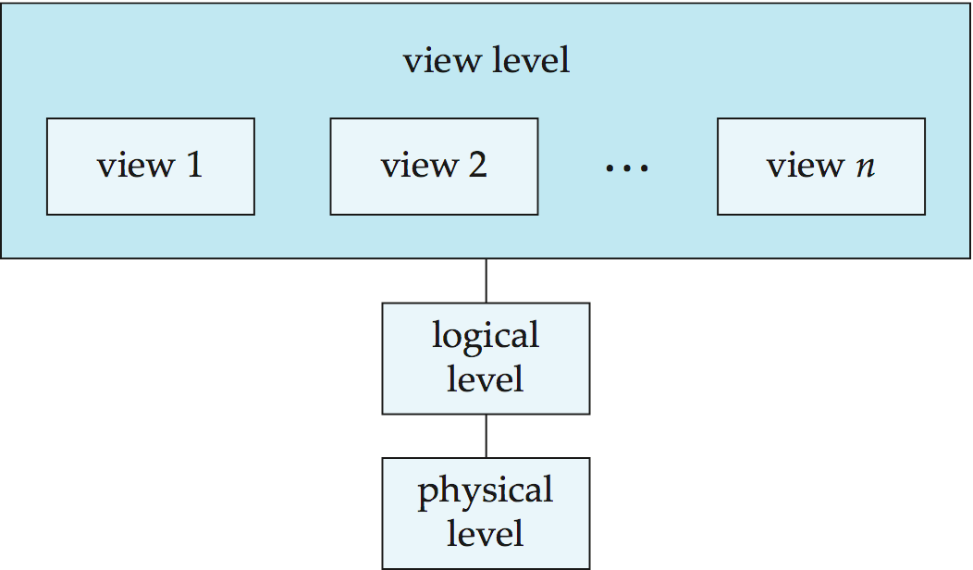
View of Data
A major purpose of a database system is to provide users with an abstract view of the data.
Fig 1 Three levels of data abstraction
Notes:
For the system to be usable, it must retrieve data efficiently. The need for efficiency has led database system developers to use complex data structures to represent data in the database. Since many database-system users are not computer trained, developers hide the complexity from users through several levels of data abstraction, to simplify users’ interactions with the system
A major purpose of a database system is to provide users with an abstract view of the data. That is, the system hides certain details
of how the data are stored and maintained.
Physical- The compiler hides this level of detail from programmers. Similarly, the database system hides many of the
lowest-level storage details from database programmers. Database administrators,
on the other hand, may be aware of certain details of the physical organization of the data.
Logical- Programmers using a programming language work at this level
of abstraction. Similarly, database administrators usually work at this level of abstraction.
View-Many views are defined at this level. In addition to hiding details of the logical level of the database,
the views also provide a security mechanism to prevent users from accessing certain parts of the database.
For example, clerks in the university registrar office can see only that part of the
database that has information about students; they cannot access information about salaries of instructors.

Slide 19
Levels of Abstraction
Physical level: Describes how a record is actually stored.
(describes entire database complex low-level data structures in detail.)
Logical level: Describes entire database using relatively simpler structures. Tells about kind of data is stored and the relationships among the data.
type customer = record
name: string;
street: char;
city: integer;
end;
View level: A view describes only part of the entire database using simple structure. There may be several such views.
For example Application programs hide details of data types.
Views can also hide information (e.g. salary) for security purposes.
Notes:
According to the levels of abstraction of the three-level architecture portrayed in the above figure, at the highest level, there is multiple external schemas (view level schema) (also called sub-schemas) that match up to different views of the data.
At the conceptual level, there is the conceptual schema or the logical schema that describes all the entities, attributes, and relationships together with integrity constraints. At the lowest level of abstraction, there is the internal schema or the physical schema that creates a complete description of the internal model, containing the classifications of stored records, the methods of representation, the data fields, storage structures used, etc. It is to be noted that there will be only one conceptual schema and one internal schema per database. The DBMS is responsible for mapping between these three types of schema.
It must also check the schemas for consistency; which means, the DBMS must check that each external schema is derivable from the conceptual schema, and must use the information in the conceptual schema for mapping among those external schemas and the internal schema. It also allows any differences in entity names; attribute names, attribute order, data types, and so on, to be determined. Lastly, each external schema is related to the conceptual schema by the external/conceptual mapping. This enables the DBMS to map names in the user's view on the relevant part of the conceptual schema.
A logical schema is a conceptual design of the database done on paper or a whiteboard, much like architectural drawings for a house. The ability to change the logical schema, without changing the external schema or user view, is called logical data independence. For example, the addition or removal of new entities, attributes or relationships to this conceptual schema should be possible without having to change existing external schemas or rewrite existing application programs.
Physical data independence refers to the immunity of the internal model to changes in the physical model. The logical schema stays unchanged even though changes are made to file organization or storage structures, storage devices or indexing strategy.
Physical data independence deals with hiding the details of the storage structure from user applications.

Slide 20
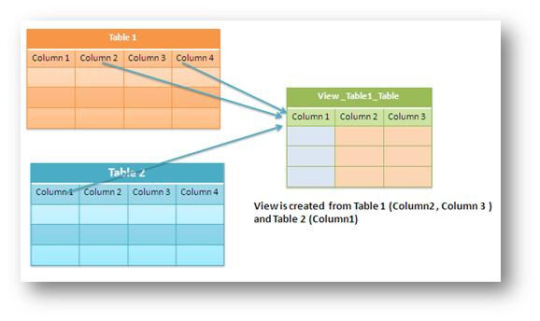
Views
Academics(Regno, Name, email,Mark1,Mark2,Mark3,Grade)
Pending_Stud_Fees_View(
Regno,Name,emailed, pending_amount)
Fees_paid (Regno, Year1_fees, Year2_Fees,Total_pending)
There can be multiple such different views according need of application/user
Notes:
There can be multiple such different views according need of application/user.
Academics(Regno, Name, email,Mark1,Mark2,Mark3,Grade)
Fees_paid (Regno, Year1_fees,Year2_Fees,Total_pending)
Pending_Stud_Fees_View(Regno,Name,emailed, pending_amount)

Slide 21
Instances and Schemas
Schema – The overall design(structure) of the database
Physical schema – database design at physical level
Logical schema – database design at the logical level
Subschemas- several schemas at the view level
Instance – The collection of information stored in the database at a particular moment.
Data is stored in which schema ? All or any one ? Which one?
Notes:
Logical schema is important.
Application programs exhibit physical data independence.
A database may also have several schemas at the view level, sometimes called
subschemas, that describe different views of the database.
Data is stored in which schema ? All or any one ?

Slide 22
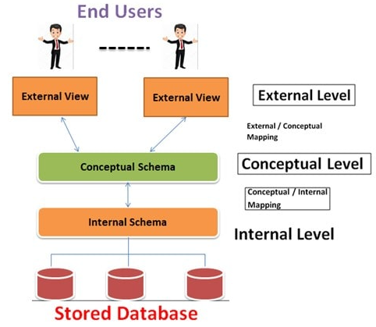
Data Independence
Ability to modify a schema definition in one level without affecting a schema definition in the other levels.
Two levels of data independence
Physical data independence
Logical data independence
Notes:
Since a DBMS separates the data descriptions from the applications, it helps make applications immune
to changes in the data descriptions. This is known as data independence and
its provision simplifies database application maintenance.
A logical schema is a conceptual design of the database done on paper or a whiteboard, much like architectural drawings for a house. The ability to change the logical schema, without changing the external schema or user view, is called logical data independence. For example, the addition or removal of new entities, attributes or relationships to this conceptual schema should be possible without having to change existing external schemas or rewrite existing application programs.
Physical data independence refers to the immunity of the internal model to changes in the physical model. The logical schema stays unchanged even though changes are made to file organization or storage structures, storage devices or indexing strategy.
Physical data independence deals with hiding the details of the storage structure from user applications.

Slide 23
Data Independence Types
Physical Data Independence
The ability to modify the physical schema without changing the logical schema.
Logical Data Independence
The ability to modify the logical schema without changing the view level.
The interfaces(mappings) between the various levels and components should be well defined so that changes in some parts do not seriously influence others.

Slide 24
Data Models
A collection of conceptual tools for describing:
Data
Data relationships
Data semantics
Consistency constraints
Notes:
Underlying the structure of a database is the data model- Data model explains using conceptual tools, how data organized

Slide 25
Data Models
Relational model
Entity-relationship model
Object-based Data model
Semistructured model
Notes:
Data that is the easiest to search and organize, because it is usually contained in rows and columns and its elements can be mapped into fixed pre-defined fields, is known as structured data. Often structured data is managed using Structured Query Language (SQL)—a programming software language developed by IBM in the 1970s for relational databases.
Unstructured The lack of structure made unstructured data more difficult to search, manage and analyzed data is data that cannot be contained in a row-column database and doesn’t have an associated data model. Other examples of unstructured data include photos, video and audio files, text files, social media content, satellite imagery, presentations, PDFs, open-ended survey responses, websites and call centre transcripts/recordings. unstructured data is usually stored in data lakes, NoSQL databases, applications and data warehouses. The wealth of information in unstructured data is now accessible and can be automatically processed with artificial intelligence algorithms today. This technology has elevated unstructured data to an extremely valuable resource for organizations.
A third category Semi-Structured Data, which basically is a mix between both of them. The type of data defined as semi-structured data has some defining or consistent characteristics but doesn’t conform to a structure as rigid as is expected with a relational database. Therefore, there are some organizational properties such as semantic tags or metadata to make it easier to organize, but there’s still fluidity in the data. Example: Email messages are a good example. While the actual content is unstructured, it does contain structured data such as name and email address of sender and recipient, time sent, etc. Another example is a digital photograph. The image itself is unstructured, but if the photo was taken on a smart phone, for example, it would be date and time stamped, geo tagged, and would have a device ID. Once stored, the photo could also be given tags that would provide a structure, such as ‘dog’ or ‘pet.’
HTML is one example of semi-structured data, in which a text and other data is organized with tags.

Slide 26
Relational Model
Example of record based model
Collection of tables to represent both data and the relationships among those data. Tables are also known as relations.
Notes:
Data that is the easiest to search and organize, because it is usually contained in rows and columns and its elements can be mapped into fixed pre-defined fields, is known as structured data. Tables are also known as relations. The relational model is an example of a record-based model. Each table contains records of a particular type. Often structured data is managed using Structured Query Language (SQL)—a programming software language developed by IBM in the 1970s for relational databases.
The relational data model is the most widely used data model, and a vast majority of current database systems.
There are principally two ways to tackle the problem. The first one is to use the entity-relationship model (Chapter 6); the other is to employ a set of algorithms
(collectively known as normalization that takes as input the set of all attributes and generates a set of tables

Slide 27
Entity-Relationship Model
Entities-collection of basic objects and relationships among these objects
customer-street
social-security
account-number
customer-name
customer-city
balance
deposit
customer
account
Fig 3 ER model (old notation)
widely used in database design
Notes:
(E-R) data model uses a collection of basic objects, called entities, and relationships among these objects.
The entity-relationship model is widely used in database design.
There are principally two ways to tackle the problem. The first one is to use the entity-relationship model (Chapter 6); the other is to employ a set of algorithms
(collectively known as normalization that takes as input the set of all attributes and generates a set of tables

Slide 28
Entity Relationship Model
Customer
Account
Deposit
Social security
Customer-name
Customer-street
Customer-city
Account No
Balance
Fig 4 ER model(New notation)
Normalization
Another method for designing a relational database.
To design set of schema with minimum redundancy.
Ensuring schema are in appropriate normal forms.
The approach is based on functional dependencies
Notes:
Normalization
Another method for designing a relational database is to use a process commonly
known as normalization. The goal is to generate a set of relation schemas that
allows us to store information without unnecessary redundancy, yet also allows
us to retrieve information easily. The approach is to design schemas that are in
an appropriate normal form. To determine whether a relation schema is in one of
the desirable normal forms, we need additional information about the real-world
enterprise that we are modeling with the database. The most common approach
is to use functional dependencies,

Slide 29
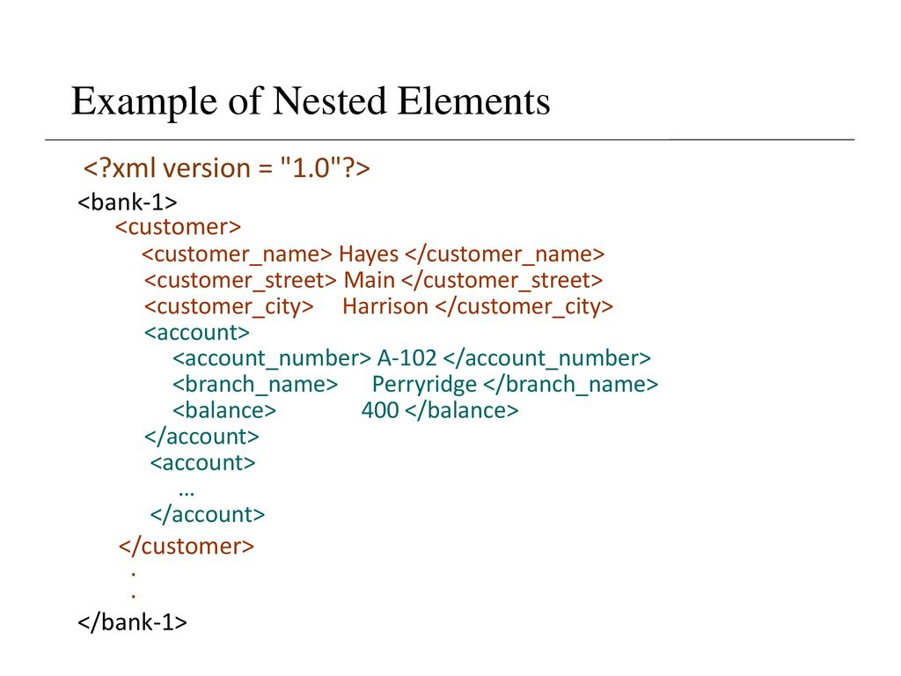
semi-structured data model
JSON and Extensible Markup Language (XML) are widely used semi-structured data representations.
The ability to specify new tags and create nested tags structures make XML best way to exchange data. Tags make data self documenting.
Database schemas constrain what information can be stored, and the data types of stored values
XML documents are not required to have an associated schema.
JSON is a light-weight alternative to XML for data- interchange Started gaining importance.
Notes:
The semi-structured data model permits the specification of data where individual data items of the same type may have different sets of attributes.
JSON(JavaScript Object Notation) and Extensible Markup Language (XML) are widely used semi-structured data representations.
The ability to specify new tags and create nested tags structures make XML nest way to exchange data. Tags make data self documenting.
A name/value pair consists of a field name (in double quotes), followed by a colon, followed by a valueUnordered sets of name/value pairsBegins with { (left brace)Ends with } (right brace)Each name is followed by : (colon)Name/value pairs are separated by , (comma)
Example:
{"employee_id": ,
"name": "Jeff Fox",
"hire_date": "1/1/2013",
"location": "Norwalk, CT",
"consultant": false}

Slide 30
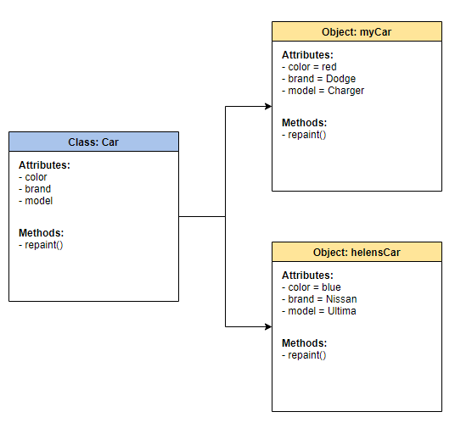
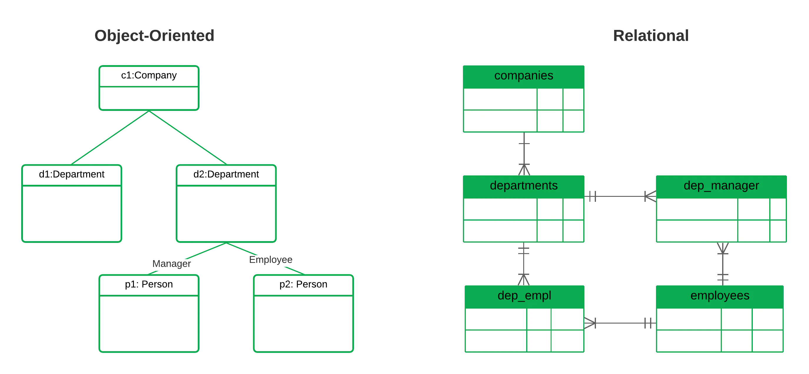
Object-based Data model
Standards exist to store objects in relational tables along with procedures to be executed in the database.
Relational model is extended with idea of encapsulation.
Notes:
Complex Data- Chpater-8 7th Edition-
Standards exist to store objects in relational tables. Database systems allow procedures to be stored
in the database system and executed by the database system. This can be seen as extending the relational model with notions of encapsulation, methods, and object
identity.
An OOD may be a great choice if you’re using an object-oriented programming language and need to manage complex data with complex object-to-object associations. Designing and optimizing a database system for these kinds of complexities.
The elements of a OODM are:
Object: A real world entity, such as a specific life task in a to-do list-“take the garbage out”.
Attributes and Methods: An object has state and behaviors. An object has properties (which might also be called attributes) like name, status, and create_date. The set of properties taken together represents its state. Along with this, an object has behaviors (also known as methods, actions, or functions) that modify or operate on its properties, like update_task() or get_task_history().
Class: The grouping of all objects with the same properties and behaviors form a class. In our example above, we talked about task objects. These objects together all belong to the Task class.
class task { String name;
String status;
Date create_date;
public void update_task(String status) { ... }
}
OODs offer the ability to query across complex relationships quickly.
Relational databases (RDBMS) store data using tables, rows, and columns. Associations between records are facilitated with foreign keys. In an OOD, data is stored and managed as objects.

Slide 31
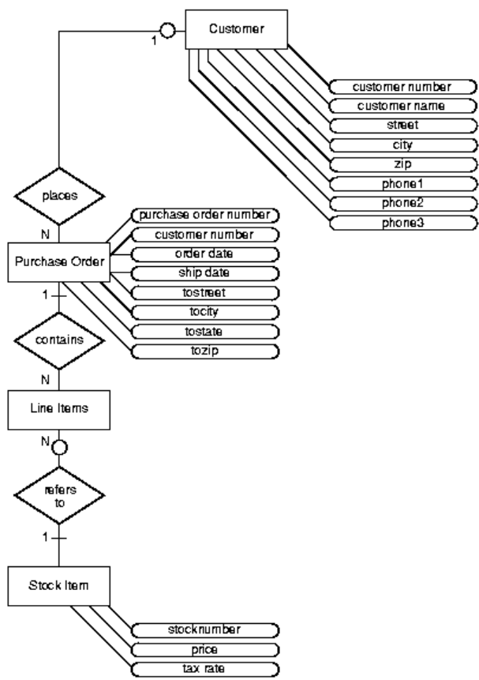
Entity-Relationship Diagram for Purchase Order Application
Notes:
CREATE TABLE Customer_reltab (
CustNo NUMBER NOT NULL,
CustName VARCHAR2(200) NOT NULL,
Street VARCHAR2(200) NOT NULL,
City VARCHAR2(200) NOT NULL,
State CHAR(2) NOT NULL,
Zip VARCHAR2(20) NOT NULL,
Phone1 VARCHAR2(20),
Phone2 VARCHAR2(20),
Phone3 VARCHAR2(20),
PRIMARY KEY (CustNo)
) ;
CREATE TABLE PurchaseOrder_reltab (
PONo NUMBER, /* purchase order no */
Custno NUMBER references Customer_reltab, /* Foreign KEY referencing
customer */
OrderDate DATE, /* date of order */
ShipDate DATE, /* date to be shipped */
ToStreet VARCHAR2(200), /* shipto address */
ToCity VARCHAR2(200),
ToState CHAR(2),
ToZip VARCHAR2(20),
PRIMARY KEY(PONo)
) ;
CREATE TABLE LineItems_reltab (
LineItemNo NUMBER,
PONo NUMBER REFERENCES PurchaseOrder_reltab,
StockNo NUMBER REFERENCES Stock_reltab,
Quantity NUMBER,
Discount NUMBER,
PRIMARY KEY (PONo, LineItemNo)
) ;
CREATE TABLE Stock_reltab (
StockNo NUMBER PRIMARY KEY,
Price NUMBER,
TaxRate NUMBER
) ;
Inserting Values Under the Relational Model
INSERT INTO Stock_reltab VALUES(1004, 6750.00, 2) ;
INSERT INTO Stock_reltab VALUES(1011, 4500.23, 2) ;
INSERT INTO Stock_reltab VALUES(1534, 2234.00, 2) ;
INSERT INTO Stock_reltab VALUES(1535, 3456.23, 2) ;
INSERT INTO Customer_reltab
VALUES (1, 'Jean Nance', '2 Avocet Drive',
'Redwood Shores', 'CA', '95054',
'415-555-1212', NULL, NULL) ;
INSERT INTO Customer_reltab
VALUES (2, 'John Nike', '323 College Drive',
'Edison', 'NJ', '08820',
'609-555-1212', '201-555-1212', NULL) ;
INSERT INTO PurchaseOrder_reltab
VALUES (1001, 1, SYSDATE, '10-MAY-1997',
NULL, NULL, NULL, NULL) ;
INSERT INTO PurchaseOrder_reltab
VALUES (2001, 2, SYSDATE, '20-MAY-1997',
'55 Madison Ave', 'Madison', 'WI', '53715’) ;
INSERT INTO LineItems_reltab VALUES(01, 1001, 1534, 12, 0) ;
INSERT INTO LineItems_reltab VALUES(02, 1001, 1535, 10, 10) ;
INSERT INTO LineItems_reltab VALUES(01, 2001, 1004, 1, 0) ;
INSERT INTO LineItems_reltab VALUES(02, 2001, 1011, 2, 1) ;
Get Customer and Line Item Data for a Specific Purchase Order
SELECT C.CustNo, C.CustName, C.Street, C.City, C.State,
C.Zip, C.phone1, C.phone2, C.phone3,
P.PONo, P.OrderDate,
L.StockNo, L.LineItemNo, L.Quantity, L.Discount
FROM Customer_reltab C,
PurchaseOrder_reltab P,
LineItems_reltab L
WHERE C.CustNo = P.CustNo
AND P.PONo = L.PONo
AND P.PONo = 1001 ;
Get the Total Value of Purchase Orders
SELECT P.PONo, SUM(S.Price * L.Quantity)
FROM PurchaseOrder_reltab P,
LineItems_reltab L,
Stock_reltab S
WHERE P.PONo = L.PONo
AND L.StockNo = S.StockNo
GROUP BY P.PONo ;
Get the Purchase Order and Line Item Data for those LineItems that Use a Stock Item Identified by a Specific Stock Number
SELECT P.PONo, P.CustNo,
L.StockNo, L.LineItemNo, L.Quantity, L.Discount
FROM PurchaseOrder_reltab P,
LineItems_reltab L
WHERE P.PONo = L.PONo
AND L.StockNo = 1004 ;

Slide 32
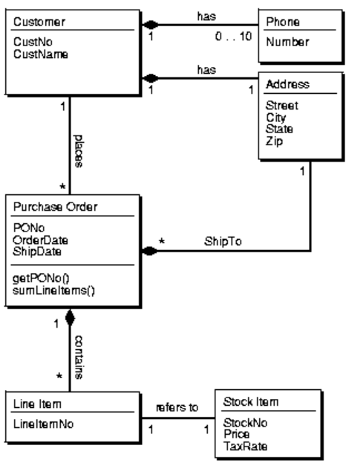
The Object-Relational Model
Class Diagram for Purchase Order Application
Notes:
The main entities—customers, stock, and purchase orders—become object types. Object references are used to express some of the relationships among them. Collection types—varrays and nested tables—are used to model multi-valued attributes.
Defining Types
You create an object type with a CREATE TYPE statement
CREATE TYPE StockItem_objtyp AS OBJECT ( StockNo NUMBER, Price NUMBER, TaxRate NUMBER );
CREATE TYPE LineItem_objtyp AS OBJECT ( LineItemNo NUMBER, Stock_ref REF StockItem_objtyp, Quantity NUMBER, Discount NUMBER );
CREATE TYPE LineItem_objtyp AS OBJECT ( LineItemNo NUMBER, Stock_ref REF StockItem_objtyp, Quantity NUMBER, Discount NUMBER );
CREATE OR REPLACE TYPE LineItem_objtyp AS OBJECT ( LineItemNo NUMBER, Stock_ref REF StockItem_objtyp, Quantity NUMBER, Discount NUMBER );
CREATE TYPE Customer_objtyp AS OBJECT ( CustNo NUMBER, CustName VARCHAR2(200), Address_obj Address_objtyp, PhoneList_var PhoneList_vartyp, ORDER MEMBER FUNCTION compareCustOrders(x IN Customer_objtyp) RETURN INTEGER ) NOT FINAL;
CREATE TYPE LineItemList_ntabtyp AS TABLE OF LineItem_objtyp;

Slide 33
Database Languages
Data Manipulation Language
Data Definition Language

Slide 34
Data Manipulation Language (DML)…
Language for accessing and manipulating the data organized by the appropriate data model.
Two classes of languages
Procedural – user specifies what data is required and how to get those data
Nonprocedural (Declarative) – user specifies what data is required without specifying how to get those data. SQL
Portion of DML that involves information retrieval is called a query language.
Notes:
Assuming that SQUR() ,Sin(Z) & Log() functions readily available the expression A=SQUR(B)+Sin(Z)*Log23 can be thought of as Non Procedural statement, because we are not mentioning procedure/steps to calculate SQUR ,Sin or Log.
dBASE /foxpro shows both procedural and non-procedural commands to list two fields in a file. The non-procedural LIST displays all the records in a file. In the 3 GL version, a logic loop must be defined (do/enddo), the next record must be read (skip), and the end of file must be tested (while .not. eof())

Slide 35
Data Definition Language (DDL)…
Specification notation for defining the database schema
Data storage and definition language(DSL) – special type of DDL in which the storage structure and access methods used by the database system are specified.
Specification notation for defining a table.
Example: create table instructor ( ID char(5), name varchar(20), dept_name varchar(20), salary numeric(8,2) )

Slide 36
..Data Definition Language (DDL)
The data values stored in the database must satisfy certain
consistency constraints.
Domain constraints- simplest is data type , size, range & pattern etc.
Referential Integrity – foreign key
Authorization – read, insert, update, delete.
DDL compiler takes instructions as input and generates some output. These outputs are stored in some a set of special tables in the data dictionary
Data dictionary contains metadata (data about data).
Data dictionary is accessed by database system only.
Database system consults Data Dictionary,
Notes:
Domain Constraints- Most Elementary integrity constraints.
The output of the DDL is placed in the data dictionary, which contains metadata—that is, data about data. The data dictionary is considered
to be a special type of table that can be accessed and updated only by the database system itself (not a regular user). The database system consults the data dictionary before
reading or modifying actual data.
An assertion is a statement in SQL that ensures a certain condition will always exist in the database.
Assertions are like column and table constraints, except that they are specified separately from table definitions.
Assertion Example-This SQL statement creates an assertion to demand that there's no more than a single president among the employees:
create assertion AT_MOST_ONE_PRESIDENT as CHECK ((select count(*)
from EMP e
where e.JOB = 'PRESIDENT') <= 1
)
An example of an assertion is:
create assertion recent_licenses
check (
( select count(*) from nurses where license_renewal_date < '2002-01-01' ) = 0 )

Slide 37
Notes:
In oracle we can identify commands relevant to different command.

Slide 38
SQL
SQL: widely used non-procedural language
Example: Find the name of the instructor with ID 22222 select name from instructor where instructor.ID = ‘22222’
SQL is as powerful to access database, but there are some computations that are possible using a general-purpose programming language.
SQL also does not support actions such as input from users, output to displays, or communication over the network.
Such computations and actions must be written in a host language, such as C, C++, or Java, with embedded SQL queries that access the data in the database.
Application programs generally access databases through one of
Language extensions to allow embedded SQL
Application program interface (e.g., ODBC/JDBC) which allow SQL queries to be sent to a database.
DML precompiler convert DML into procedural calls in the Host Language
Notes:
38

Slide 39
// Importing SQL libraries to create database
import java.sql.*;
public class GFG {
// Step1: Main driver method
public static void main(String[] args)
{
// Step 2: Making connection using
Connection con = null;
PreparedStatement p = null;
ResultSet rs = null;
con = connection.connectDB();
// Try block to catch exception/s
try {
// SQL command data stored in String datatype
String sql = "select * from cuslogin";
p = con.prepareStatement(sql);
rs = p.executeQuery();
Example: JAVA & SQL Embeded code
System.out.println("id\t\tname\t\temail");
// Condiion check
while (rs.next()) {
int id = rs.getInt("id");
String name = rs.getString("name");
String email = rs.getString("email");
System.out.println(id + "\t\t" + name
+ "\t\t" + email);
}
}
// Catch block to handle exception
catch (SQLException e) {
// Print exception pop-up on scrreen
System.out.println(e);
}
}
}
Notes:
// Java Program retrieving contents of
// Table Using JDBC connection
// Java code producing output which is based
// on values stored inside the "cuslogin" table in DB

Slide 40
namespace AccessingDatabase{
class Program{
static void Main(string[] args){
using( SqlConnection conn=new SqlConnection()){
conn.ConnectionString = "server=ABC; database=Stud_DB; Integrated Security=True";
try{
SqlCommand cmd = new SqlCommand();
cmd.CommandType = CommandType.Text;
cmd.CommandText = "SELECT RegNo FROM StudRegistration";
cmd.Connection = conn;
conn.Open();
//Execute the query
SqlDataReader sdr= cmd.ExecuteReader();
while(sdr.Read()){
int id = (int)sdr["id"];
Console.WriteLine(id);
}
conn.Close(); }
catch (Exception ex){
Console.WriteLine("Can not open connection !");
} } } } }
Example: C# SQL Embeded code
Notes:
Example: C# code

Slide 41
Example: C++ SQL Embeded code
#include<stdio.h>
#include <SQLAPI.h> // main SQLAPI++ header
int main(int argc, char* argv[]){
SAConnection con; // connection object to connect to database
SACommandcmd; // create command object
try{
con.Connect("test", "tester", "tester", SA_Oracle_Client);
cmd.setConnection(&con);
cmd.setCommandText("create table tbl(id number, name varchar(20));");
cmd.Execute();
cmd.setCommandText("Insert into tbl(id, name) values (1,”Vinay”)");
cmd.setCommandText("Insert into tbl(id, name) values (2,”Kushal”)");
cmd.Execute();
con.Commit();
printf("Table created, row inserted!\n");
}
catch(SAException &x){
try{
con.Rollback();
}
catch(SAException &) { }
printf("%s\n", (const char*)x.ErrText());
}
return 0;
}

Slide 42
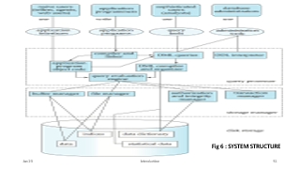
SYSTEM STRUCTURE of DBMS Data Storage and Querying
The functional components of a database system can be broadly divided into the storage manager and the query processor.
Storage manager – Manages large amount of space by interacting with file manager.
Query Processor – Simplify and facilitate access to the data.
-Access data without understanding physical level details.
- Convert nonprocedural to efficient sequence of operations
Notes:
Based on Functionality –
Storage Manager
Query Processor
Offers good performance to user working at view level without worrying about physical level details. It is the job
of the database system to translate updates and queries written in a nonprocedural language, at the logical level, into an efficient sequence of operations at the physical level.

Slide 43

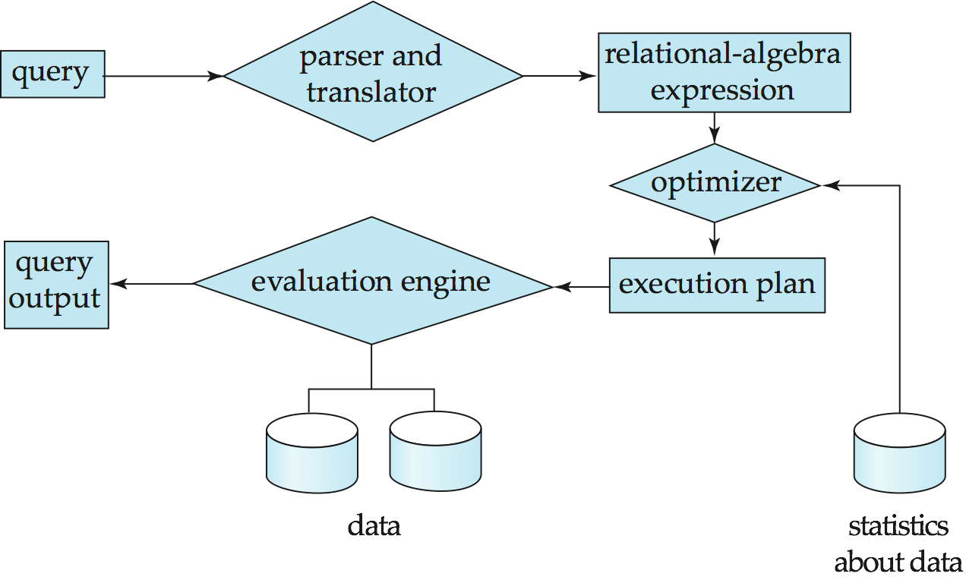
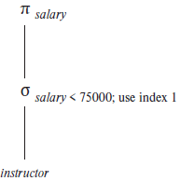
Query Processing
1. Parsing and translation
2. Optimization
3. Evaluation
Ex: select salary
from instructor
where salary < 75000;
Translate updates and queries written in a nonprocedural language, at the logical level, into an efficient sequence of operations at the physical level.
Two possible relational Algebraic expression.
A query-evaluation plan.
Notes:
43
Two possible relational Algebraic expression.(chapter 15 , page 690)
In detail studied in latter chapters.
1st step:
The system must translate the query into a form suited to be the system’s internal representation of a query.
A more useful internal representation is one based on the extended relational algebra.
2nd step:
Each SQL query can itself be translated into a relational algebra expression in one of several ways.
select salary from instructor where salary < 75000;
Executed in two different ways –
1. SELECT salary <75000 (PROJECT salary (instructor))
2. PROJECT salary SELECT (salary<75000 (instructor))
we can execute each relational-algebra operation by one of several different algorithms.
Also annotate each operation with instructions specifying how to evaluate each operation(which algorithm or/and using index.
A relational algebra operation annotated with instructions on how to evaluate it is called an evaluation primitive.
A sequence of primitive operations that can be used to evaluate a query is a query-execution plan or query-evaluation plan.
The different evaluation plans for a given query can have different costs. We do not expect users to write their queries in a way that suggests the most efficient
evaluation plan. Rather, it is the responsibility of the system to construct a query evaluation plan that minimizes the cost of query evaluation; this task is called query optimization.
Once the query plan is chosen, the query is evaluated with that plan, and the result of the query is output.
To do so, we must estimate the cost of individual operations, and combine them to get the cost of a query evaluation plan.
There are multiple possible evaluation plans for a query, and it is important to be able to compare the alternatives in terms of their (estimated) cost, and choose
the best plan.
3rd step:
Query Evaluation Engine – executes low level instructions generated by the DML compiler. query-execution engine takes a query-evaluation plan, executes
that plan, and returns the answers to the query.

Slide 44
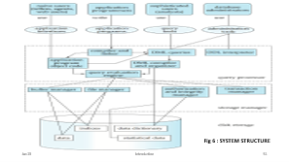
Query Processor
Components:
DDL interpreter – interprets DDL statements and records the definitions in the data dictionary.
DML Compiler – translates DML statements in a query language into an evaluation plan. It also performs query optimization.
Query Evaluation Engine – executes low level instructions generated by the DML compiler.
figure
Notes:
DDL interpreter, which interprets DDL statements and records the definitions in
the data dictionary.

Slide 45
Storage Manager
A storage manager is a program module that provides the interface between the low-level data stored in the database and the application programs and queries submitted to the system.
The storage manager is responsible for the following tasks:
Interaction with the file manager
Efficient storing, retrieving, and updating of data
figure
Notes:
File manager (operating system)– creating, deleting and modification of files and managing access ,security and resources used by them
1. Keeping track of each file. In the system, the File Manager keeps track of each file through directories that contain the file’s name, location in secondary storage and other important information.
2. Using of the policies that determine where & how the files would be stored, in order to efficiently use the available storage and provide access to them. It has a set of predetermined policies that decides where and how the files would be stored and how the user will be able to gain access to them.
3. Allocating each file when the user is granted access to them, and recording their use. The File Manager allocates the files by activating the appropriate secondary storage device and loading the file into the main memory while also updating the records of who is using what file.
4. Deallocating the files when their use in finished and are not needed, and also communicating to others about it’s availability which are waiting for it. It deallocates the file by updating the file tables and rewriting the updated file into the secondary storage, then communicating with other processes and notifying them about it’s availability.

Slide 46
Storage Manager
The storage manager component include:
Authorization and integrity manager – tests for the satisfaction of integrity constraints and checks the authority of the users to access data.
Transaction manager – ensures that database remains in a consistent state despite system failures and that concurrent transaction execution proceeds without conflicting.
File Manager – allocation of space in the disk storage and manages the data structures used to represent information stored on disk.
Buffer Manager – Fetching data from disk storage into main memory and deciding what data to cache in main memory. Allows handling Data size larger than memory
figure
Notes:
Buffer manger intelligently shuffles data from main memory to disk. It happens transparently to high-level DBMS operations. Generally OS uses algorithms like LRU(least Recently Used) or MRU (Most Recently Used) similarly DBMS uses many different algorithms to manage Buffer.

Slide 47
Storage Manager
Data structures used are:
Data files – store the database
Data dictionary – stores metadata
Indices – provide fast access to data items

Slide 48
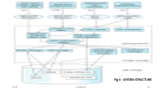
Transaction Management
A transaction is a collection of operations that performs a single logical unit in a database application.
Transaction-management component ensures that the database remains in a consistent (correct) state despite system failures (e.g. power failures and operating system crashes) and transaction failures.
Transaction manager consists of concurrency control manager and the recovery manager.
Concurrency-control manager controls the interaction among the concurrent transactions, to ensure the consistency of the database.
Recovery manager - Ensuring the atomicity and durability property
Notes:
A transaction is a collection of operations that performs a single logical unit in a database application.
Transaction-management component ensures that the database remains in a consistent (correct) state despite system failures (e.g. power failures and operating system crashes) and transaction failures.
Transaction manager consists of concurrency control manager and the recovery manager
Concurrency-control manager controls the interaction among the concurrent transactions, to ensure the consistency of the database. Not all concurrent executions result in a correct state.
The database system must control the interaction among the concurrent transactions to prevent them from destroying the consistency of the database.
Recovery manager - Ensuring the atomicity and durability property. An integral part of a database system is a recovery
scheme that can restore the database to the consistent state that existed before the failure.
The recovery scheme must also support high availability

Slide 49
Database Administrator
Coordinates all the activities of the database system; the database administrator has a good understanding of the enterprise’s information resources and needs.
Database administrator’s duties include:
Schema definition.
Storage structure and access method definition.
Schema and physical organization modification.
Granting user authority to access the database.
Periodically backing up the data.
Ensuring enough free disk space is available.
Monitoring the jobs that may degrade performance and responding to changes in requirements.
Notes:
The difference is that storage structure has data stored in the memory of the computer system, whereas file structure has the data stored in the auxiliary memory.

Slide 50
Database Users
Users are differentiated by the way they expect to interact with the system.
Naive users: (unsophisticated user) invoke one of the permanent application programs that have been written previously.
Application programmers: are computer professionals who write application programs.
Sophisticated users: form their requests in a database query language or data analysis software.
Notes:
Specialized Users:
Specialized users are sophisticated users who write specialized database application that does not fit into the traditional data-processing framework. Among these applications are computer aided-design systems, knowledge-base and expert systems etc.
Sophisticated Users:
Sophisticated users form their requests in a database query language and submit them to a query processor to make the storage manager understand the requests. Analysts who submit queries to explore data in the database fall in this category.

Slide 51
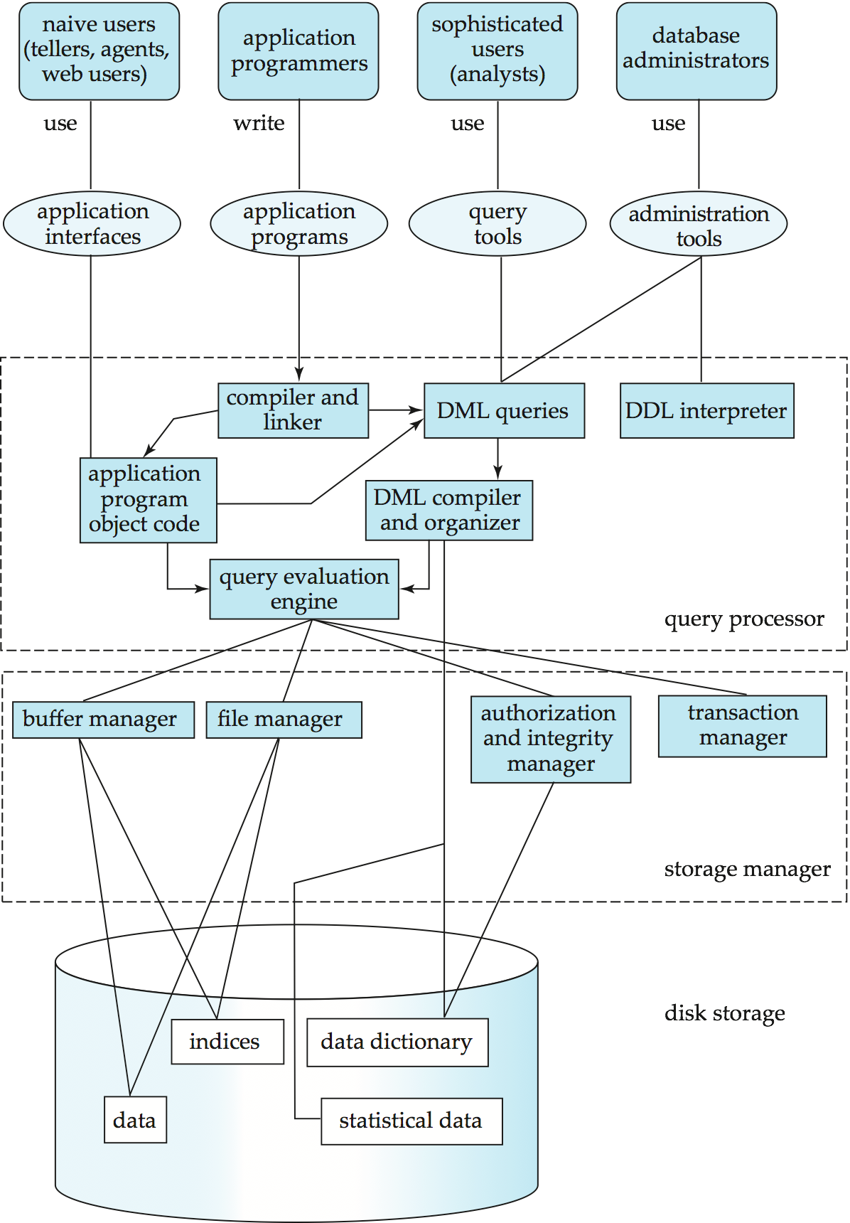
Fig 6 : SYSTEM STRUCTURE

Slide 52
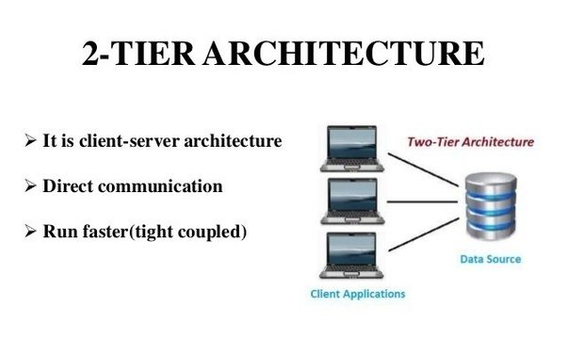
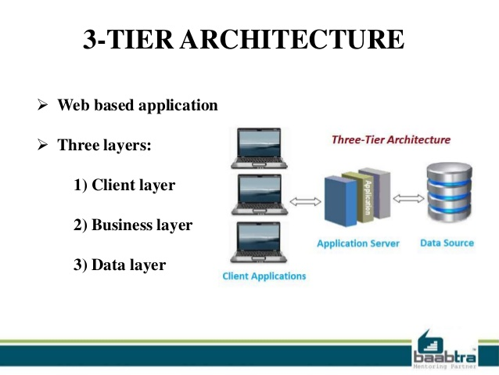
Database Application Architecture
Notes:
Definition - What does Two-Tier Client/Server mean?
A two-tier client/server is a type of multi-tier computing architecture in which an entire application is distributed as two distinct layers or tiers. It divides the application logic, data and processing between client and server devices.
A two-tier client/server works when most or all of the application logic and data is hosted on a server. The client integrates with the presentation layer and accesses the server for application specific tasks and processing.
In a two-tier architecture, the client is on the first tier. The database server and web application server reside on the same server machine, which is the second tier.
3-Tier Architecture
A three-tier client/server is a type of multi-tier computing architecture in which an entire application is distributed across three different computing layers or tiers. It divides the presentation, application logic and data processing layers across client and server devices.
A three-tier client/server adds an additional layer/tier to the client/server-based two-tier models. This additional layer is a server tier that acts as an intermediary or middleware appliance. In a typical implementation scenario, the client or first tier holds the application presentation/interface and broadcasts all of its application-specific requests to the middleware tier server. The middleware or second tier calls the application logic server or third tier for application logic. The distribution of the entire application logic across three tiers helps optimize the overall application access and layer/tier level development and management.
We now consider the architecture of applications that use databases as their backend.
Database applications can be partitioned into two or three parts, as shown in
Figure 1.4. Earlier-generation database applications used a two-tier architecture, where
the application resides at the client machine, and invokes database system functionality
at the server machine through query language statements.
In contrast, modern database applications use a three-tier architecture, where the
client machine acts asmerely a front end and does not contain any direct database calls;
web browsers and mobile applications are the most commonly used application clients
today. The front end communicates with an application server. The application server,
in turn, communicates with a database system to access data. The business logic of the
application, which says what actions to carry out under what conditions, is embedded
in the application server, instead of being distributed across multiple clients. Threetier
applications provide better security as well as better performance than two-tier
applications

Slide 53
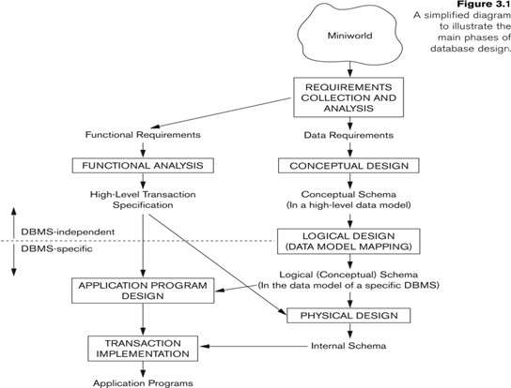
Database Design
User Requirement Specifications
Translate into Conceptual Schema of the Database.
ER-Model- entity, attributes, relationship
More details about logical structure of database such as tables, columns, primary key, foreign key constraints etc.
Database Requirement Specification
Choose a DBMS and implement database along with
physical features such as file organization, access methods index.
Notes:
There are principally two ways to tackle the problem. The first one is to use the entity-relationship model (Chapter 6); the other is to employ a set of algorithms
(collectively known as normalization that takes as input the set of all attributes and generates a set of tables
Step-1 (Requirements)
The Database design team (business analyst/domain experts/ s/w developer/Database programmer) interacts with stakeholders (users/employees/management officials) to understand business processes/policy framework & business rules. The outcome of this phase is User Requirement Specifications
User Requirement Specifications- important document that defines scope of s/w project and these mentioned data requirements must be satisfied by the application being developed.
Step-2 (Conceptual Schema)
The database designer has to choose appropriate data model and applying data model concepts the requirements must be translated into Conceptual Schema of the Database. Conceptual data model is simpler diagrammatic overview of the data needs of the enterprise only highlighting various database entities and relationships between entities.
Designer reviews the conceptual schema to confirm all the data requirements are met and remove if any redundant features exist in the design.
Basically, making the decision what tables (roughly entities) and how to group attributes under each table(entity)
Example: ER Data Model
There are two ways to do Using ER Model or Normalization (by applying set of algorithms).
A fully developed conceptual schema indicates Functional requirements of the enterprise. The kind of operations (insert/update/delete/search etc.) to be performed on the data that satisfy the functional requirements are specified in the Functional requirement specification.
At this stage designer ensures that all the data required to meet functional requirement is available.
Conceptual data model is independent of DBMS.
Step-3
Next step is logical schema design. Designer maps Conceptual schema onto the implementation data model of the database system chosen. Logical data model describes more details about logical structure of database such as tables, columns, primary key, foreign key constraints etc.
Designer finalize and define the design features in to a document called Database Requirement Specification which must satisfy functional requirements and User Requirement specification document.
Still it is independent of DBMS.
Step-4
Choose a DBMS (Oracle, MySQL etc.) for creating physical data model. Designer use resulting database specific schema in physical design phase along with file organization and storage structures required.

Slide 54
END of the CHAPTER

